Slide 1
British Airways
Customer ratings analysis and insights
26-05-2023

Slide 2
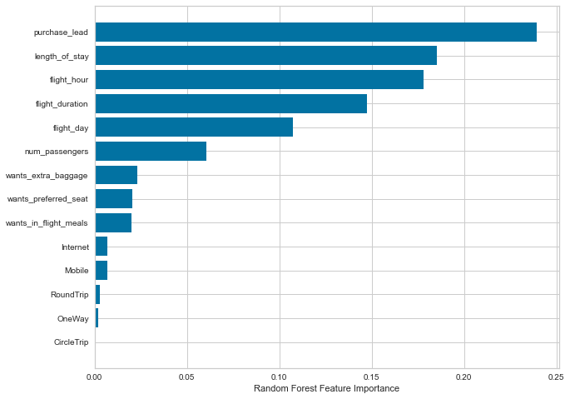
Predictive Modelling Results
Recall Rate
60%
Precision
61%
Chances of predicting true successful Bookings
Will be predicted as actually completed bookings out of all successfully completed bookings.
Accuracy
62%
We are concerned with not predicting the successful bookings correctly. Imbalance dataset drives higher accuracy but it does not accurately predict the successful bookings. Dataset was balanced with 8k labelled as incomplete bookings and 7k as complete bookings.
Accuracy of the model predicting successful or incomplete booking is

